Slide 1



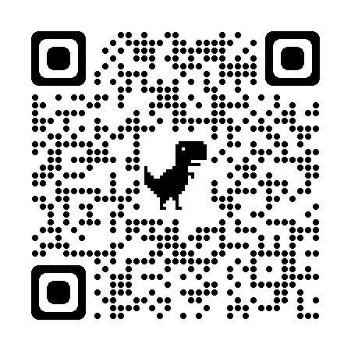
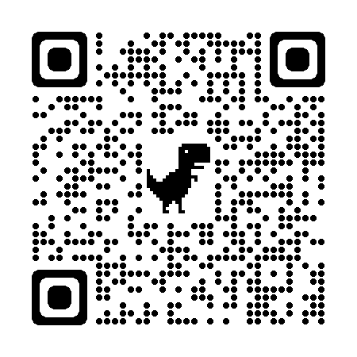
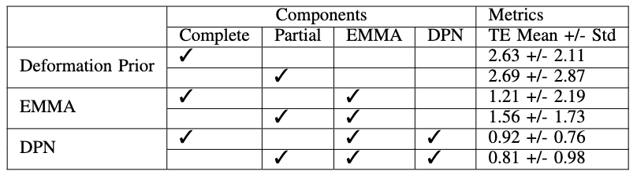
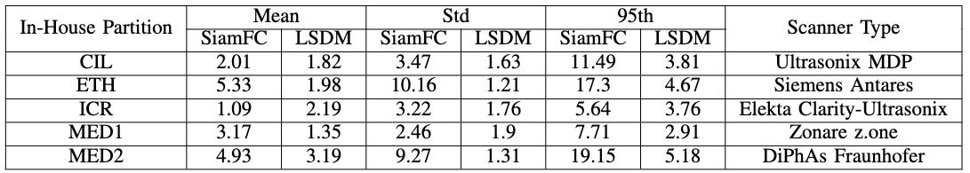
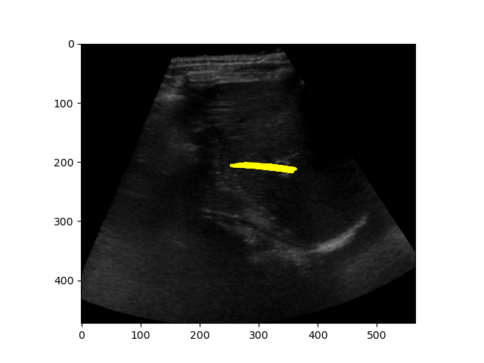
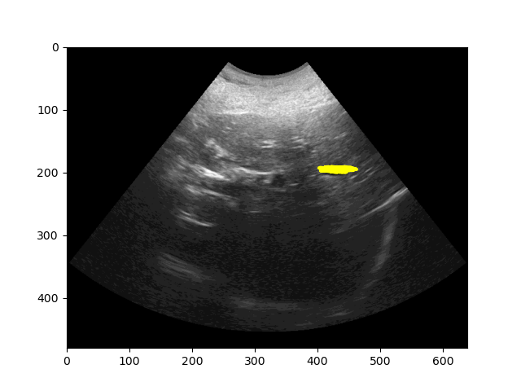
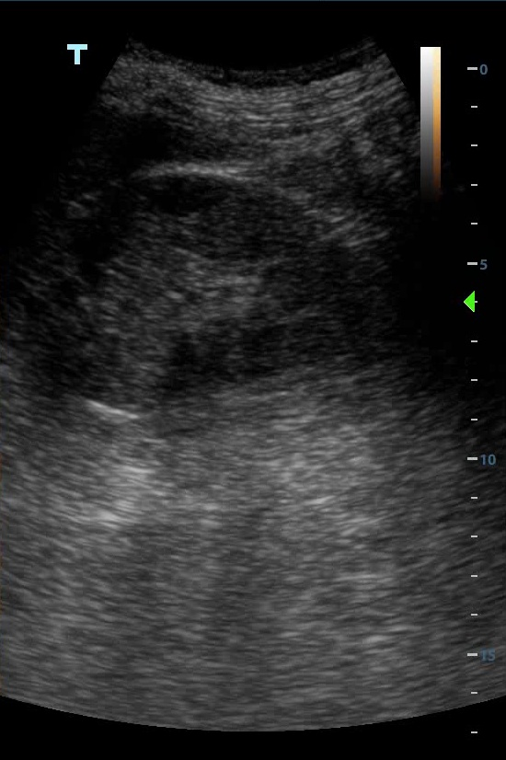
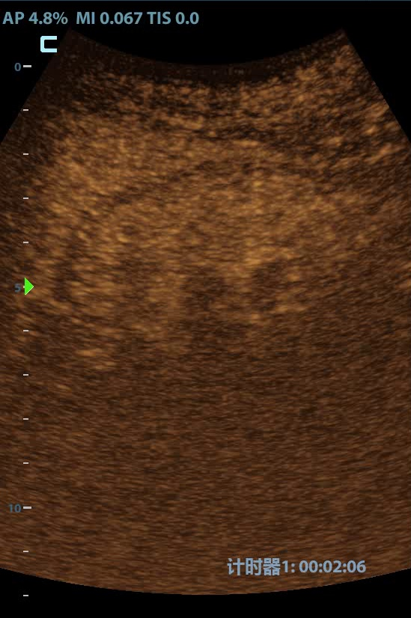
LSDM: Long-Short Diffeomorphic Motion for Weakly-Supervised Ultrasound Landmark Tracking
Full Paper
Find Zhihua here
Zhihua Liu, Bin Yang, Xuejun Ni, Yan Shen, Huiyu Zhou
Ultrasound Landmark Tracking
Long-Short Diffeomorphic Motion Network (LSDM)
Tracking Visualization
What: The goal is to locate the same landmark provided by the exemplar frame in the follow-up image sequences.
Why: Delivers landmark localization and movement estimation information in temporal-spatial domains, which provides clinicians a measurable therapy margin around clinical and surgical target to increase the chance of tumor control.
With EM-Based Motion Alignment (EMMA):
Deformation Pyramid Network boost Tracking Net
Ablation Study
Tracking with Novel Motion Representation
✭Multi-Task: A novel landmark tracking network by multi-tasking both tracking and motion learning.
No significant performance difference between Partial (Right-Top) and Complete (Bottom-Right).
In-House Test
✭Long-Short Representation: A new representation design containing diffeomorphism in both long and short intervals.
Datasets
Test sequence from a specific scanner is hidden during training.
✭Weakly-Supervised: Only few landmark annotations for tracking and zero annotation for motion learning.
Public: CLUST2D(Liver) Private: Affiliated Hospital of Nantong University(Kidney)
Failure Cases
Low confidence map
Online Latency
V. De Luca, et al., “Evaluation of 2d and 3d ultrasound tracking algorithms and impact on ultrasound-guided liver radiotherapy margins,” Medical Physics, vol. 45, no. 11, pp. 4986–5003, 2018
https://clust.ethz.ch/data.html

